Slide 2
Write Python code in a .py script
Python compiles the source code into bytecode .pyc files
Python virtual machine converts bytecode into machine code
Machine code is executed on computer and program produces output

Slide 3
Real dataset
Real samples
Discriminator
Generator loss
Random input
Synthetic data generator
Synthetic samples
Discriminator loss

Slide 4
Input
Output
Latent space
Encoder
Decoder

Slide 5




Slide 6




up.sql
down.sql
Migrate up
Old schema New schema
Migrate down

Slide 7
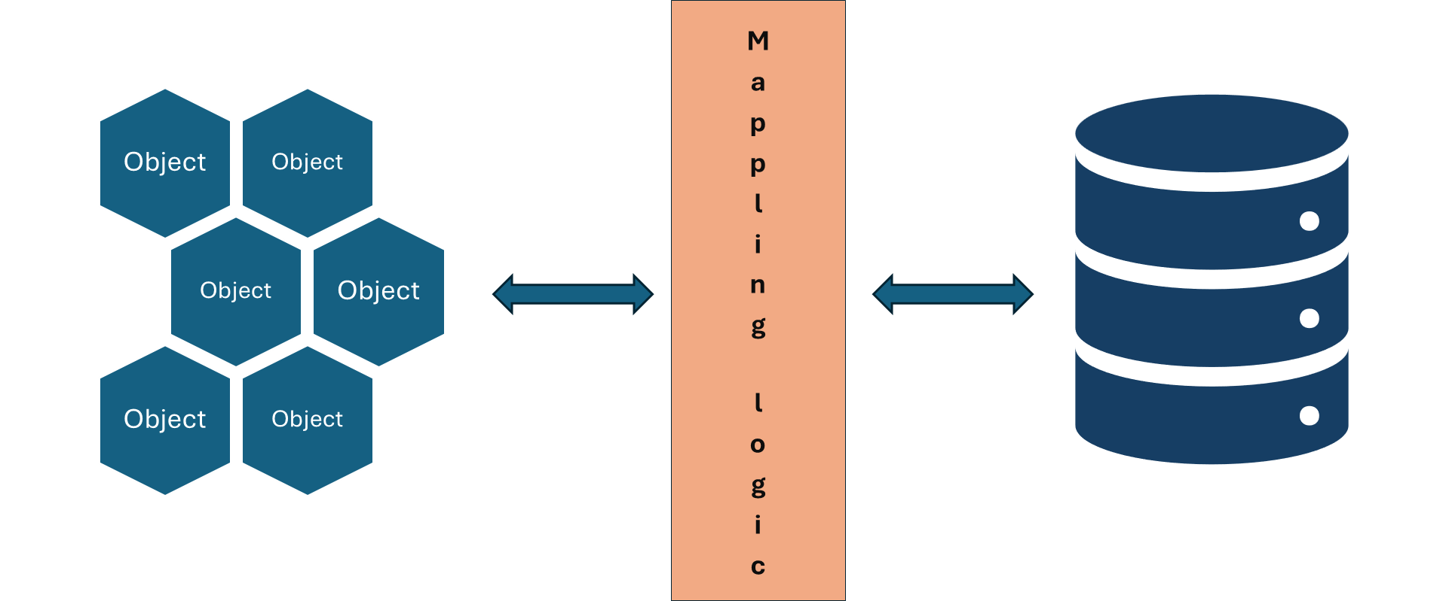

Object
Object
Object
Object
Object
Object
Mappling logic

Slide 8




Your Python application
PayPal API Server
Sender
Receiver

Slide 9
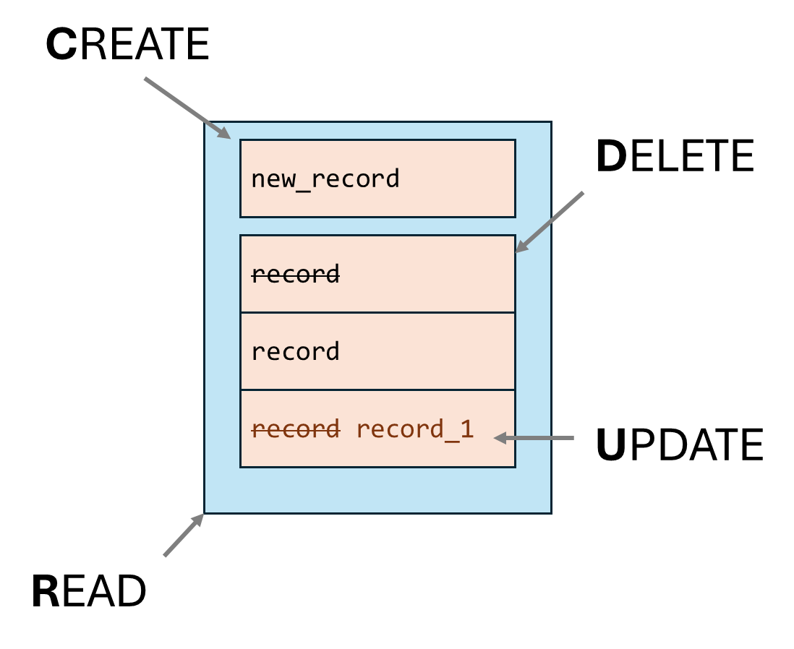
CREATE
DELETE
UPDATE
new_record
record
record
record record_1
READ

Slide 10
Web Browser
Flask Development Server
Flask application
GET
HTML/CSS response
http://localhost:5000/
Request
Response
@app.route('/')
def index():
return "Hello World!"
Hello, world!

Slide 12
Interpreter: Converts user input into structured data for processing
User Input
Tracker: Maintains the state of the conversation.
Policy: Decides the next action based on the current state.
Tracker Update: Updates the conversation state after action execution.
Response Generated: Sends the final response back to the user.
Action: Executes the selected action (e.g., retrieving data, responding).

Slide 13
Define Project Scope and Objectives
Understand what you're trying to achieve.
Identify project goals, objectives, and desired outcomes.
Analyze Existing Resources
Review available technology, team skills, budget, and time.
Evaluate Technical Requirements
Identify programming languages, frameworks, databases, and third-party integrations.
Assess Technological Risks
Highlight potential challenges: obsolescence, integration issues, security risks, scalability.
Explore Alternative Solutions
Compare different approaches or technologies to mitigate risks.
Develop a Proof of Concept (POC)
Create a small-scale prototype for critical features.
Document Your Findings
Compile a detailed feasibility report with scope, requirements, resources, risks, and solutions.
Review and Revise
Iteratively refine the assessment as new information emerges.

Slide 14
Evaluate Technical Requirements
Programming Languages: Identify suitable programming languages
Frameworks and Libraries: Select frameworks to accelerate development.
Databases: Choose a database for efficient data storage.
Third-Party Integrations: Plan external services or APIs.

Slide 15
Scenario | Without a Communication Plan | With a Communication Plan
Evolving Website | - Misinterpretation of client's needs (❌) - Costly revisions (❌) - Delayed timelines (❌) - Strained client relationship (❌) | - Clear understanding of client's needs (✅) - Efficient design iterations (✅) - On-time delivery (✅) - Strengthened client trust (✅)
Complex AI Integration | - Miscommunication on security protocols (❌) - Potential delays (❌) - Frustrated client (❌) | - Aligned understanding of security protocols (✅) - Proactive issue resolution (✅) - Improved client satisfaction (✅)

Slide 16
Power Platform
Power Automate
Excel
Office Scripts

Slide 18



Infrastructure code (scripts, templates, policies, etc)
Infrastructure automation tools (Azure SDK for Python, Azure PowerShell, etc)
Push
Pull
Code
Developer
Infrastructure
Version control

